Slide 1
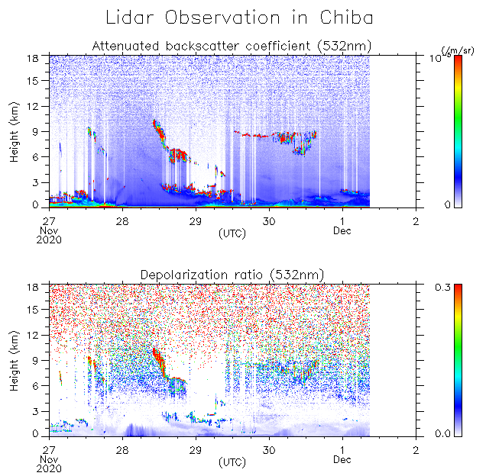
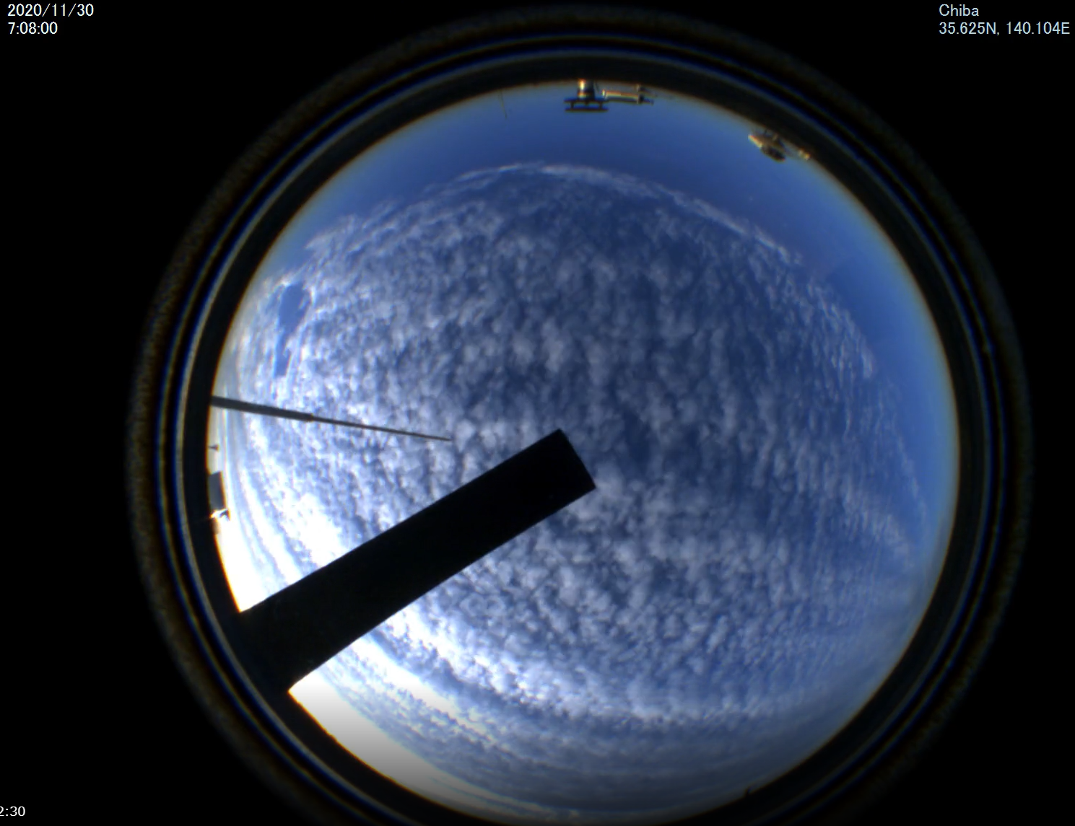
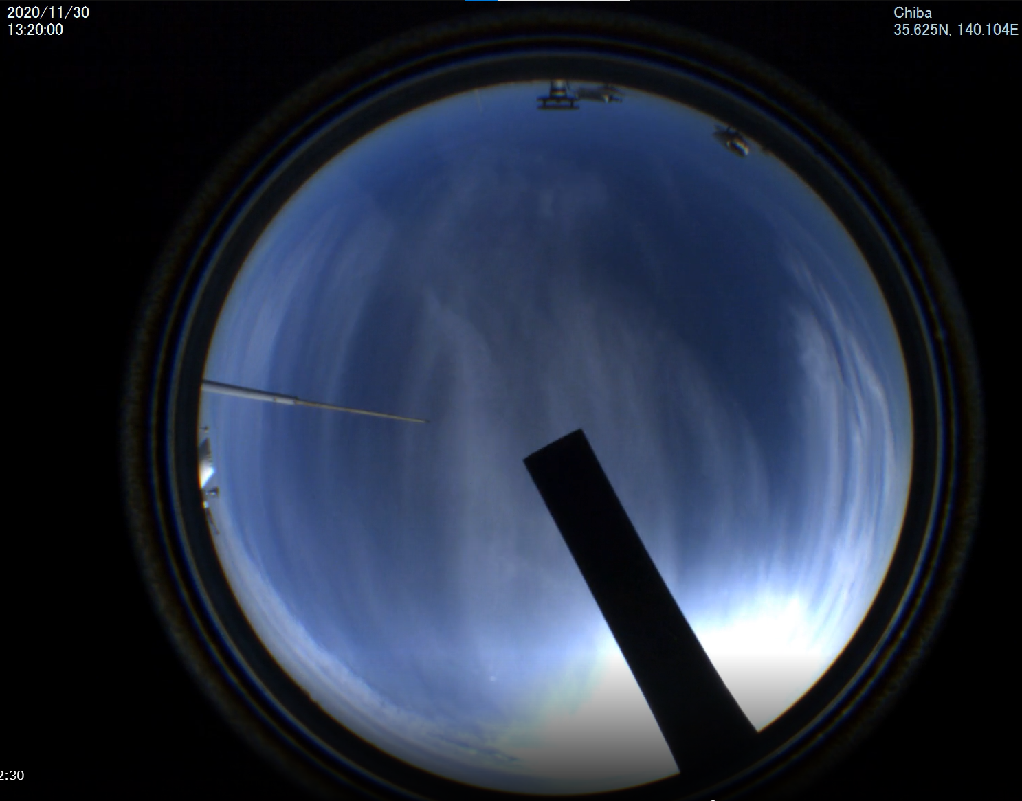
Analysis of NIES lidar data
Yesterday’s clouds (cirrocumulus and cirrus) were at about 8-9 km.
depolarization ratio is not high
→ clouds composed of supercooled solution?

Slide 2
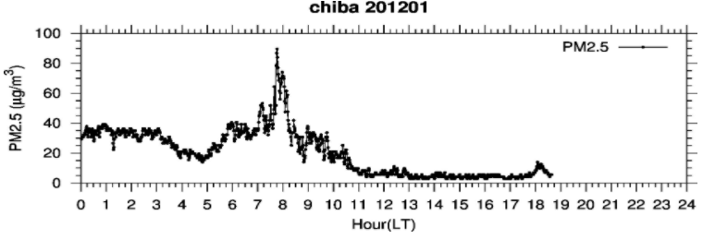
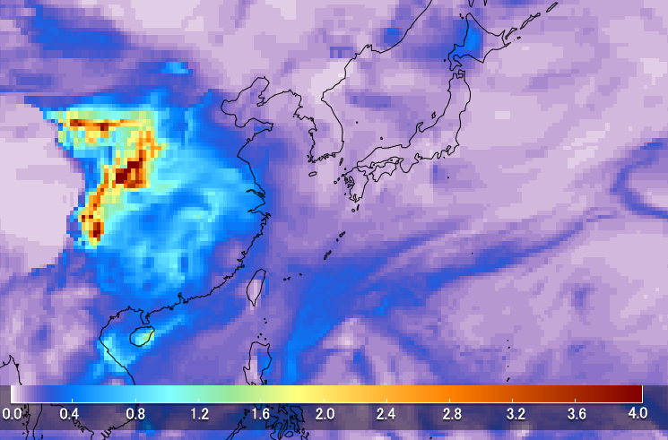
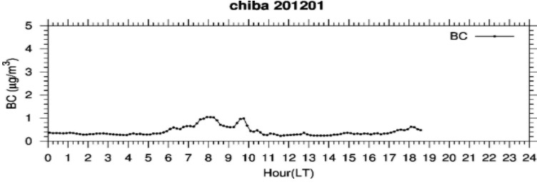
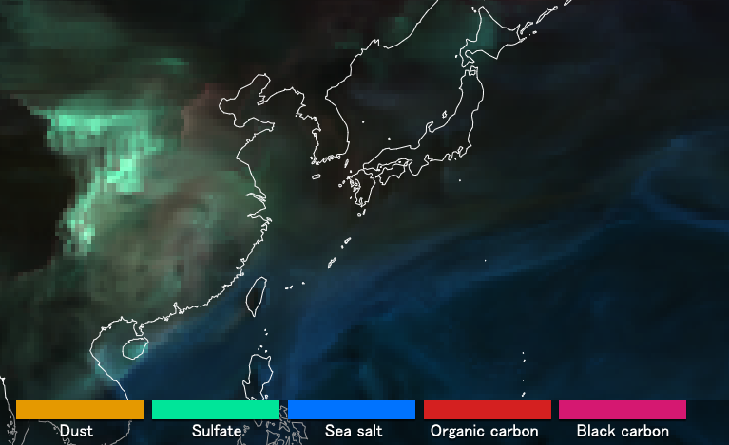
High PM_{2.5} (&BC) was observed in the morning of Dec. 1
MASINGAR AOD
MASINGAR aerosol type
※Himawari monitor
The MASINGAR model does not show the observed high value of aerosols.
→ local emission? but the high value was long-last for more than 3 hrs.
→ emission from ships (Kashima port)? or missing source?

